Slide 1
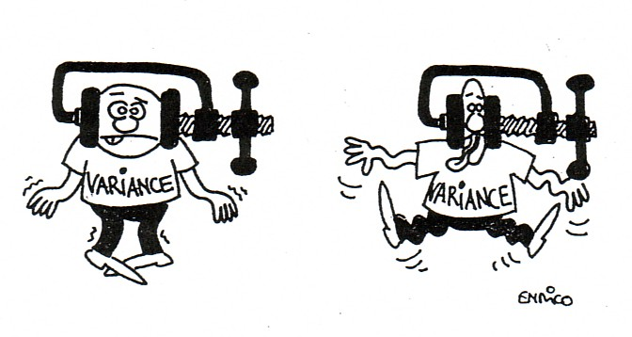
Chapter 11: The ANalysis Of Variance (ANOVA)
http://www.luchsinger-mathematics.ch/Var_Reduction.jpg

Slide 2
11.1: One-Way ANOVA - Goals
Provide a description of the underlying idea of ANOVA (how we use variance to determine if means are different)
Be able to construct the ANOVA table.
Be able to perform the significance test for ANOVA and interpret the results.
Be able to state the assumptions for ANOVA and use diagnostics plots to determine when they are valid or not.

Slide 3
ANOVA: Terms
Factor: What differentiates the populations
Level or group: the number of different populations, k
One-way ANOVA is used for situations in which there is only one factor, or only one way to classify the populations of interest.
Two-way ANOVA is used to analyze the effect of two factors.

Slide 4
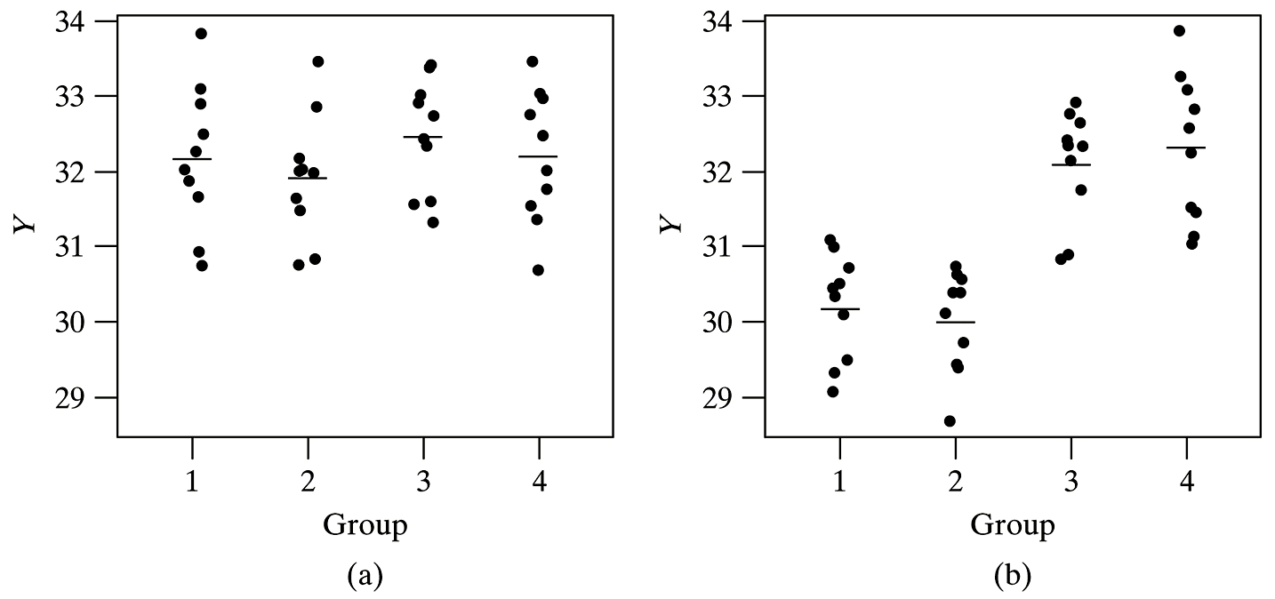
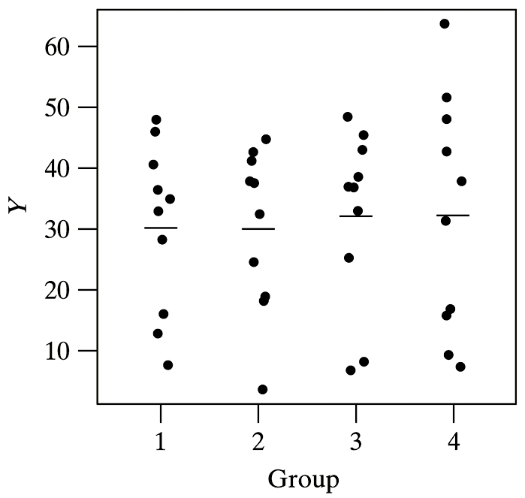
ANOVA: Graphical
c)

Slide 5
Assumptions for ANOVA
We have k independent SRSs, one from each population. We measure the same response variable for each sample.
The ith population has a Normal distribution with unknown mean μ_{i}.
All the populations have the same variance σ², whose value is unknown.

Slide 6
ANOVA: model
x_{ij}
i: group or level
k: the total number of levels
j: object number in the group
n_{i}: total number of objects in group i
μ_{i}
X_{ij} = μ_{I} + ε_{ij}
DATA = FIT + RESIDUAL
ε_{ij} ~ N(0,σ²)

Slide 7
ANOVA: model (cont)
$${\overline{x}}_{i}.=\frac{\sum_{j=1}^{n_{i}}{x_{ij}}}{n_{i}}$$
$$s_{i}^{2}=\frac{\sum_{j=1}^{n_{i}}{{\left(x_{ij}−{\overline{x}}_{i}\right)}^{2}}}{n_{i}−1}=\frac{{SS}_{x}}{df}$$
$$n=\sum_{i=1}^{k}{n_{i}}$$
$$\overline{x}..=\frac{\sum_{i=1}^{k}{\sum_{j=1}^{n_{i}}{x_{ij}}}}{n}$$

Slide 8
ANOVA test

Slide 9
ANOVA test
Analysis of variance compares the variation due to specific sources with the variation among individuals who should be similar. In particular, ANOVA tests whether several populations have the same means by comparing how far apart the sample means are with how much variation there is within a sample.

Slide 10
Formulas for Variances
$$Var=\frac{{SS}_{X}}{n−1}=\frac{SS}{df}=MS$$
SS: Sum of squares
MS: mean square

Slide 11
ANOVA Table: Formulas
Source | df | SS | MS (Mean Square) | F
Factor A (between) | k – 1
Error (within) | n – k
Total | n – 1
$$s=\sqrt{MSE}$$

Slide 12
F Distribution
http://www.vosesoftware.com/ModelRiskHelp/index.htm#Distributions/
Continuous_distributions/F_distribution.htm

Slide 13
ANOVA Hypothesis test: Summary
H₀: μ₁ = μ₂ = ⋅⋅⋅ = μ_{k}
H_{a}: At least two μ_{i}’s are different
Test statistic:
P-value: P(F ≥ F_{ts}) has a F_{α,dfa,dfe} distribution

Slide 14
t test vs. F test
$$t_{ts}^{2}=F_{ts}$$
2-sample independent | ANOVA
Same or different σ² | Same σ²
1 or 2 tailed | Only 2 tailed
Δ₀ ∈ real number | Δ₀ = 0
Only 2 levels | More than 2 levels

Slide 15
11.2: Comparing the Means - Goals
State why you have to use multi-comparison methods vs. 2-sample t procedures.
Be able to state when the Bonferroni method should be done and generally state the method.
Be able to state when the Tukey method should be done and perform the method.
Be able to state when the Dunnett method should be done.
Be able to draw conclusions from the results of the multi-comparison method.

Slide 16
Which mean(s) is different?
Graphics
Multiple comparisons
No prior knowledge

Slide 17
Problems with multiple pairwise t-tests
Type I error
Estimation of the standard deviation
Structure in the groups

Slide 18
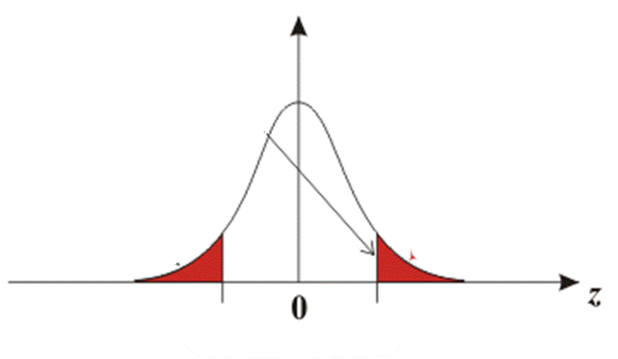
Problem with Multiple t tests

Slide 19
Overall Risk of Type I Error in Using Repeated t Tests at α = 0.05

Slide 20
Simultaneous Confidence Intervals
$${\overline{x}}_{i.}−{\overline{x}}_{j.}±t_{column,df}^{}∙SE$$
$${\overline{x}}_{i.}−{\overline{x}}_{j.}±t_{column,df}^{∗∗}∙\sqrt{MSE\left(\frac{1}{n_{i}}+\frac{1}{n_{j}}\right)}$$
$${\overline{x}}_{i.}−{\overline{x}}_{j.}±t_{column,df}^{∗∗}∙\sqrt{\frac{2MSE}{n_{i}}}$$

Slide 21
Multiple Comparison Methods
LSD (Fishers)
Bonferroni
Tukey
Dunnet

Slide 22
Bonferroni Method
$$t_{column,dfe}^{∗∗}= t_{α/{2c,n−k}}^{}$$
Problems
Type I error is usually much less than expected.
If c is large, every difference becomes significant.
If we repeated this experiment many times, in 95% of these repetitions each and every of the c confidence intervals would capture the corresponding difference.

Slide 23
I am a Turkey, not Tukey!
Thank you for not eating
me!

Slide 24
Other Methods
Tukey
$$t_{column,df}^{∗∗}=\frac{Q_{α,k,n−k}}{\sqrt{2}}$$
Used if all pairwise comparisons are used.
Dunnett
Only used if there is a control
$$t_{column,df}^{∗∗}=d_{α,k,n−k}^{}$$

Slide 25
Procedure: Multiple Comparison
Perform the ANOVA test (obtain the ANOVA table); only continue if the results are statistically significant.
Select a family significance level, α.
Select the multiple comparison methodology.
Calculate t**.
Calculate all of the confidence intervals required by the procedure.
Determine which ones are statistically significant.
Visually display the results.
Write a conclusion in the context of the problem.

